Slide 1
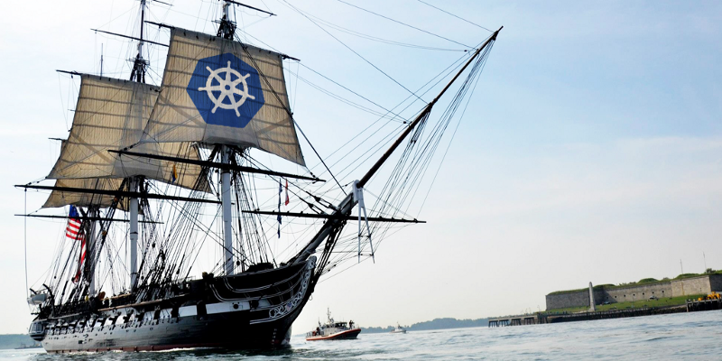
Using Kubernetes
Day 1

Slide 2
Agenda
Microservices Architecture
What is Kubernetes?
Kubernetes Basics Commands

Slide 3
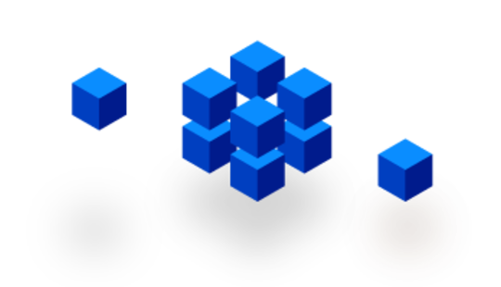
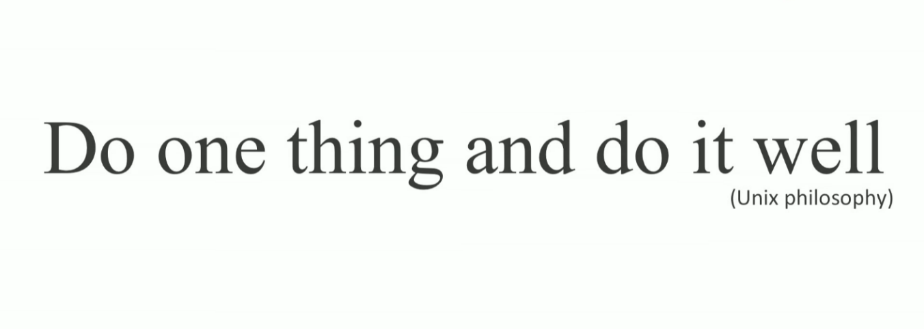
Microservices

Slide 4
Typical MVC Application
User Interface
What if the application keeps growing?
Business-Logic
Data Layer
DB

Slide 5
Typical MVC Application
User Interface
FileView
OrderView
AccountView
ProjectView
Adding more and more functionality until…
- render
- render
- render
- render
Business-Logic
FileLoader
AcctController
Auth
OrderController
ProjectController
LoginController
createOrder
showOrder
- account
- user
- permissions
createOrder
showOrder
show
create
- user
Data Layer
File
Order
Account
Permissions
Project
path
content
type
account
id
user
role
permissions
name
orders
User
username
password
FS
DB

Slide 6
Monolithic Architecture
User Interface
FileView
OrderView
AccountView
ProjectView
It becomes a massive monolith that is almost impossible to maintain and eats way too much CPU and RAM.
- render
- render
- render
- render
Business-Logic
FileLoader
AcctController
Auth
OrderController
ProjectController
LoginController
createOrder
showOrder
- account
- user
- permissions
createOrder
showOrder
show
create
- user
Data Layer
File
Order
Account
Permissions
Project
path
content
type
account
id
user
role
permissions
name
orders
User
username
password
FS
DB

Slide 7
Monolithics Limitations
Application too large and complex to fully understand
Impact of a change usually not predictable
Bug in one module (e.g. memory leak) could potentially bring down the entire application
On each update – need to redeploy the entire application.
Barrier in adopting new technologies or frameworks
Size of application increase build time and slows down start-up time.
Continues deployment is difficult.

Slide 8
Split the application into smaller chunks
User Interface
Business-Logic
Data Layer
DB
FS

Slide 9
Split the application into smaller chunks
File-Service
User Interface
Mgmt
Orders-Service
Account-Service
Auth
Notofication-Service
Payment-Service
FS
DB
DB
DB
DB

Slide 10
Split the application into smaller chunks
User Interface
http
http
http
File-Service
http
Mgmt
http
Orders-Service
http
Auth
Notofication-Service
Account-Service
Payment-Service
FS
DB
DB
DB
DB

Slide 11
Host-centric Infrastructure
User Interface
http
=
The old way to deploy applications
heavyweight, non-portable, Relies on OS package manager
http
http
File-Service
http
Mgmt
http
Orders-Service
http
Auth
Notofication-Service
Account-Service
Payment-Service
Binaries/Libraries
libyaml
libxslt
libicu
Ruby
Node
npm
Java
FS
DB
DB
DB
DB
libssl
libxml
libpq
Mysql-Client
Redis-tools
Host Operating System Kernel

Slide 12

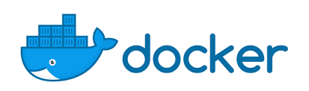
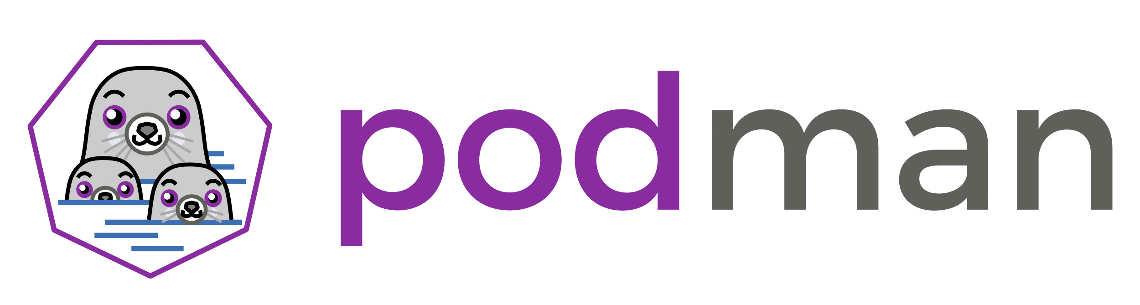
Container-centric Infrastructure
User Interface
Bin/Lib
Mgmt
http
http
Bin/Lib
=
The new way to deploy applications
Small and fast, portable, Uses OS-level virtualization
File-Service
http
http
http
Bin/Lib
Auth
Orders-Service
Bin/Lib
Bin/Lib
Account-Service
Payment-Service
Bin/Lib
Bin/Lib
Docker Engine or (podman/rkt)
Binaries/Libraries
Host Operating System Kernel

Slide 13
Docker
Docker is a container OS-level virtualization
Container use multiple isolated user space instances
In this way we can run multiple applications on same OS, while each application can only see the container's contents and devices
Docker images become container when they run on docker engine

Slide 14
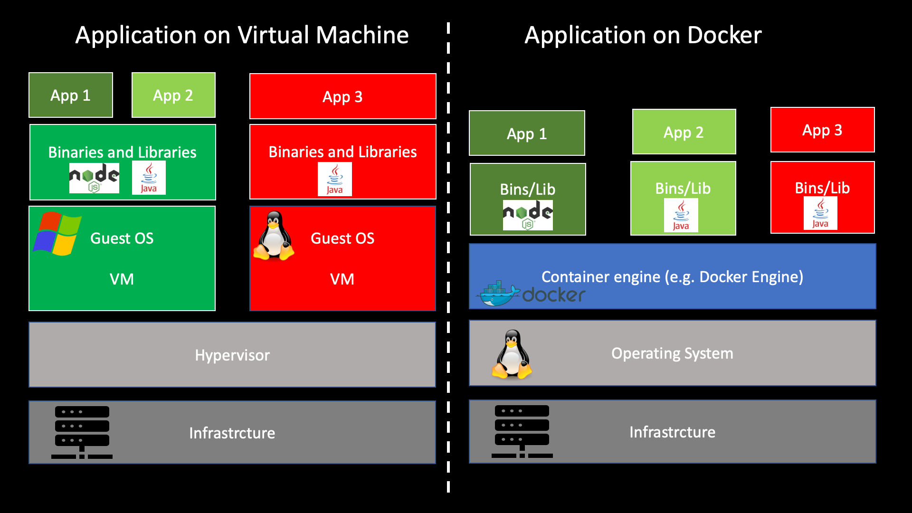
VM vs Docker

Slide 15
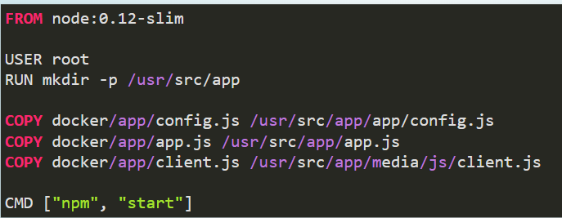
Dockerfile

Slide 16
Containers Benefits
Loosely coupled, distributed, elastic, liberated micro-services
Application-centric management
Environmental consistency across development, testing, and production
Continuous development, integration, and deployment
Resource isolation

Slide 17
Agenda
A microservice is an isolated, loosely-coupled unit of development that works on a single concern.
Microservices Architecture
What is Kubernetes?
What is Kubernetes?
Kubernetes Basics

Slide 18
Microservices Challenges ?

Slide 19
Microservices Challenges
Auto scale - add more resources to your app upon load
Load balancing - split the work between multiple containers
Service discovery - find the ip address of a peer container
Health monitoring
Configuration and secrets
Redundancy - keep working if one compute is gone

Slide 20
How can we
meet the challenges?

Slide 21
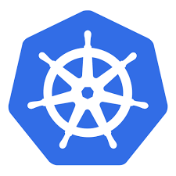
k8s

Slide 22
Kubernetes (aka. K8s)
Kubernetes (aka K8s) is an open-source container orchestration system for automating software deployment, scaling, and management.
Google originally designed Kubernetes, but the Cloud Native Computing Foundation now maintains the project.
Community includes Google, Red Hat, and over 3000 contributors.
The name Kubernetes originates from Greek, meaning helmsman or pilot.

Slide 23
Pod - the basic building block of Kubernetes
IP address
10.10.10.2
Containerized app
VM#3
VM#1
VM#2

Slide 24
Pod
A Pod represents a unit of deployment:
a single instance of an application in Kubernetes
The Pod might consist of either a single container or a small number of containers that are tightly coupled and that share resources.

Slide 25
Master
Pod
Kube-apiserver
etcd
Kube-scheduler
Kube-controller-manager
Docker
kublet
kublet
Docker
Node
Node Processes
Kubernetes Cluster
kublet
Docker

Slide 26

Kubernetes Cluster

Slide 27

kubectl create deployment my-app …
Master
Node#3
Docker
kublet
Node#1
kublet
Docker
Node#2
Kubernetes Cluster
kublet
Docker

Slide 28
Kubectl
kubectl is the command-line tool for manage K8s.
kubectl command format:
kubectl [command] [TYPE] [NAME] [flags]
command: Specifies the operation that you want to perform on one or more resources, for example create, get, describe, delete.
TYPE: Specifies the resource type
NAME: Specifies the name of the resource. If the name is omitted, details for all resources are displayed
flags: Specifies optional flags

Slide 29
Kubectl context
A configuration in Kubernetes defining access parameters for a specific cluster environment.
Components :
Cluster: Address and certificate authority data.
User: Credentials such as tokens or certificates.
Namespace: Default namespace for kubectl commands if unspecified
Benefits:
Efficiently manage and switch between multiple clusters.
Ensure consistent access settings for different environments (development, staging, production).
Reduce repetitive configuration and enhance operational efficiency.

Slide 30
Kubectl configuration file
apiVersion: v1
clusters:
- cluster:
certificate-authority-data: LS0tLS1CRUdJTi...
server: https://127.0.0.1:52941
name: prod
contexts:
- context:
cluster: prod
namespace: foo
user: eylon
name: prod-foo
current-context: local-prod
kind: Config
preferences: {}
users:
- name: eylon
user:
client-certificate-data: LS0tLS1CRUdJTiB...
client-key-data: LS0tLS1CRUdJTiBS...

Slide 31
K8s basic commands

Slide 32
Let’s connect to our k8s

Slide 33
Context Commands
kubectl config view # Show kubeconfig settings
kubectl config get-contexts # Display list of contexts
kubectl config current-context # Display the current-context kubectl config use-context my-cluster-name # Set the default context to my-cluster-name
KUBECONFIG=~/.kube/config:~/.kube/kubconfig2 # Set variable where to find the kubectl config files

Slide 34
Namespace
Namespaces are a way to organize clusters into virtual sub-clusters
Namespaces can be helpful when different teams or projects share a Kubernetes cluster
Each namespace is logically separated from other namespace, so each user/team fill he lives alone in the cluster

Slide 35
Using Namespaces
kubectl get ns # list namespaces
kubectl –n em088y get po # list pods in namespace em088y

Slide 36
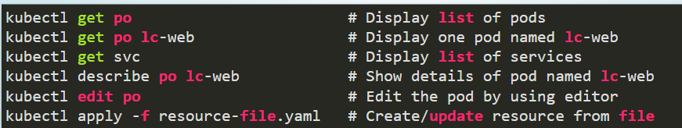
kubectl command examples

Slide 37
Working with kubectl Imperative Commands
Deploy and Explore an Application (Lab: task-1)
# create a single pod with nginx container
$ kubectl run my-app --image=nginx
# create a deployment with nginx container
$ kubectl create deployment my-app --image=nginx
# list all pods
$ kubectl get po
# stream pod logs (stdout)
$ kubectl logs –f my-app
# run command in a pod
$ kubectl exec –it my-app bash
# forward port 80 of pod to port 10080 on your local machine
$ kubectl port-forward my-app 10080:80
# show more details about po including all events
$ kubectl describe po my-app

Slide 38
Pod
Pods are designed as relatively ephemeral, disposable entities.
Pods are managed in Kubernetes via Controllers

Slide 39
Controller
A Controller can create and manage multiple Pods for you, handling replication and rollout and providing self-healing capabilities at cluster scope.
Some examples of Controllers:
Deployment
StatefulSet
DaemonSet

Slide 40
Master
Pod
Deployment
D
D
D
Docker
kublet
kublet
Docker
Node
Node Processes
Kubernetes Cluster
kublet
Docker

Slide 41
kubectl create deploy my-app …
D
Master
Node#3
Docker
kublet
Node#1
kublet
Docker
Node#2
Kubernetes Cluster
kublet
Docker

Slide 42
kubectl expose deploy …
10.30.0.2:5672
10.40.0.2:80
D
D
Master
S
10.97.14.200:5673
Node#3
S
10.105.128.60:8080
kublet
Docker
Node#1
kublet
Docker
10.32.0.3:5672
10.43.0.2:80
Node#2
Kubernetes Cluster
kublet
Docker

Slide 43
Service
A Service routes traffic across a set of Pods
The set of Pods targeted by a Service is usually determined by a LabelSelector (selector: app …)
A Service is an abstraction that allow pods to die and replicate in Kubernetes without impacting your application.
Discovery and routing among Pods is handled by Kubernetes Services.

Slide 44
Working with kubectl Imperative Commands
Expose and Scale your Application (Lab: task-2)
# Create a service for my-app deployment, on port 80 and connects to the containers on port 8000.
$ kubectl expose deployment my-app --port=80 --target-port=8000
# List all services
$ kubectl get svc
# List pods and show all labels as the last column
$ kubectl get po --show-labels
# Scale a deployment named 'foo' to 3.
$ kubectl scale deploy my-app --replicas=3

Slide 45
First, Microservices Challenges…

Slide 46

VM#3
VM#1
VM#2

Slide 47
Challenge 1:
Auto Deploy
Auto Scale
VM#3
VM#1
VM#2

Slide 48
Challenge 2:
Load Balancing
VM#3
VM#1
VM#2

Slide 49
Challenge 3:
Service Discovery
red:1880
VM#3
VM#1
VM#2

Slide 50
Challenge 4:
Zero Downtime deploys
VM#3
VM#1
VM#2

Slide 51
Challenge 5:
Health Checks
VM#3
VM#1
VM#2

Slide 52
Challenge 6:
Distribute Configuration and Secrets
VM#3
VM#1
VM#2

Slide 53
Challenge 7:
Storage Management
VM#3
VM#1
VM#2

Slide 54
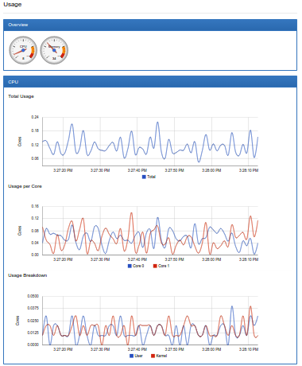
Challenge 8:
Monitoring Resources
VM#3
VM#1
VM#2

